Slide 1
Seven sea travel agency
Capstone project sem-3 on java (eclipse IDE)

Slide 2
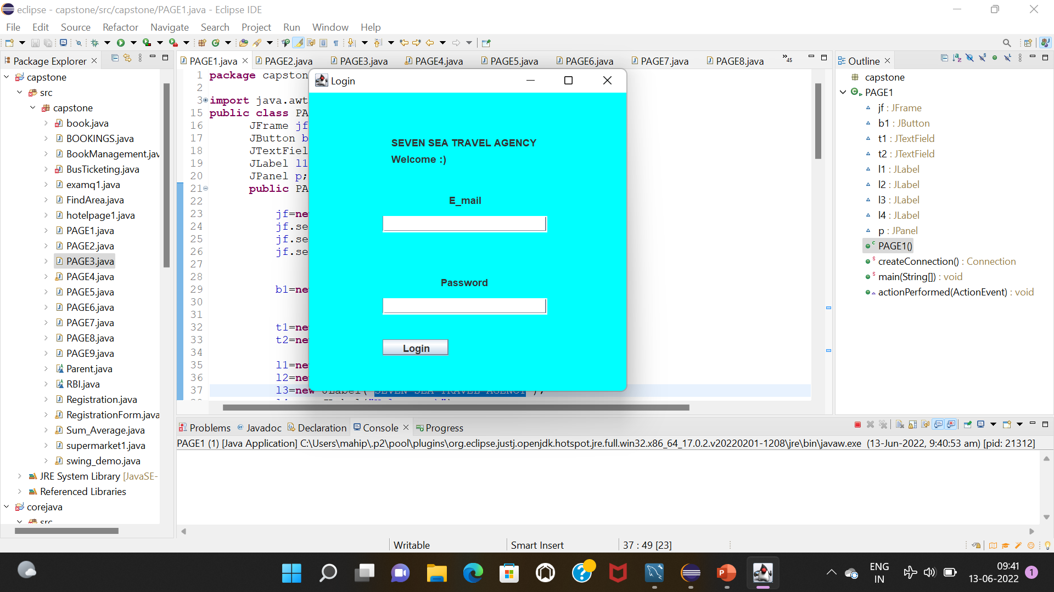
First page :
Insert email and password
And click to login button

Slide 3
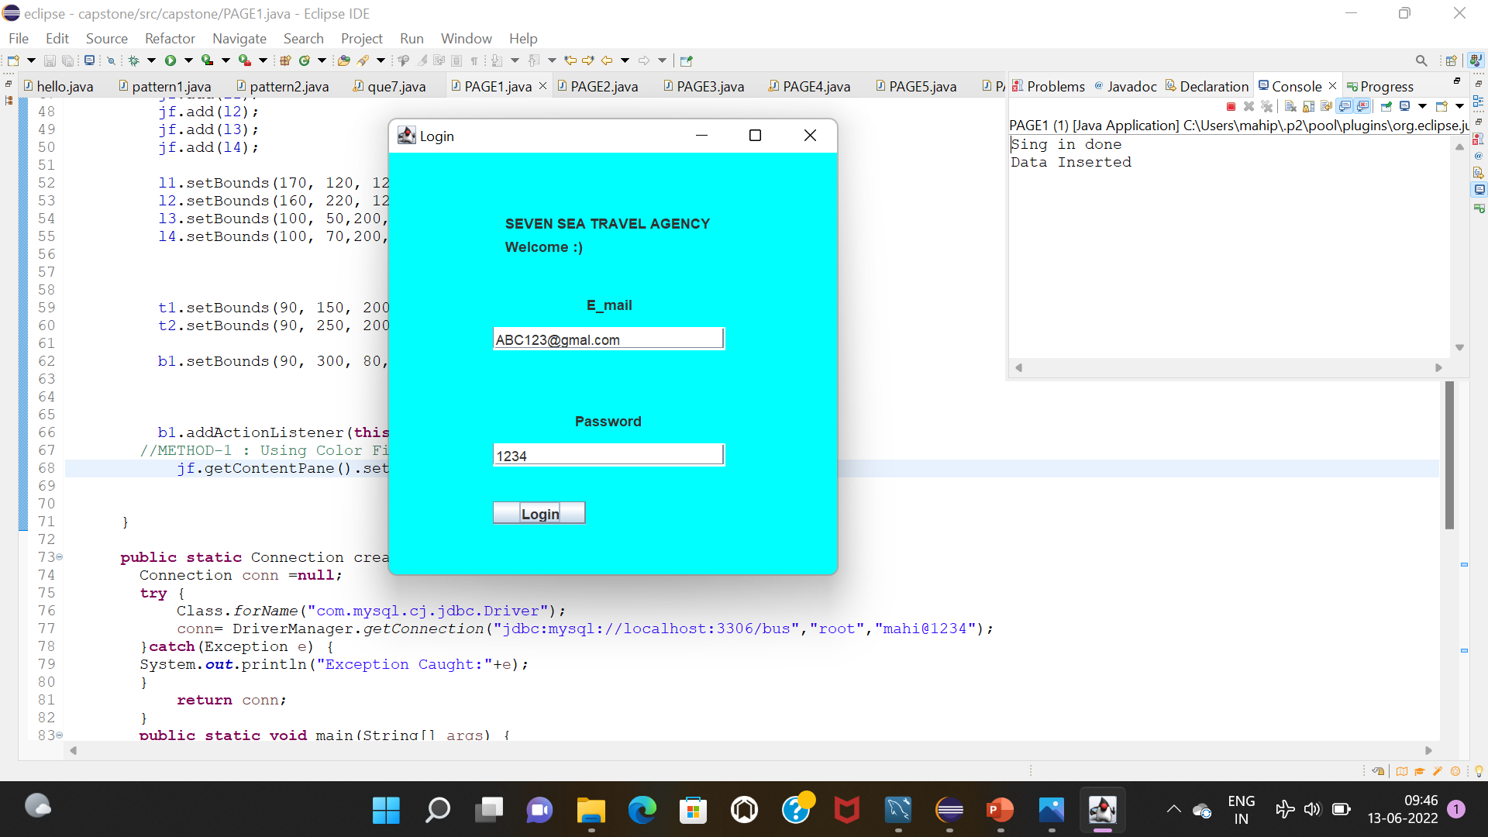
Console:
When you click login button the console bar is open and generate the massage and also save in My Sql database

Slide 4
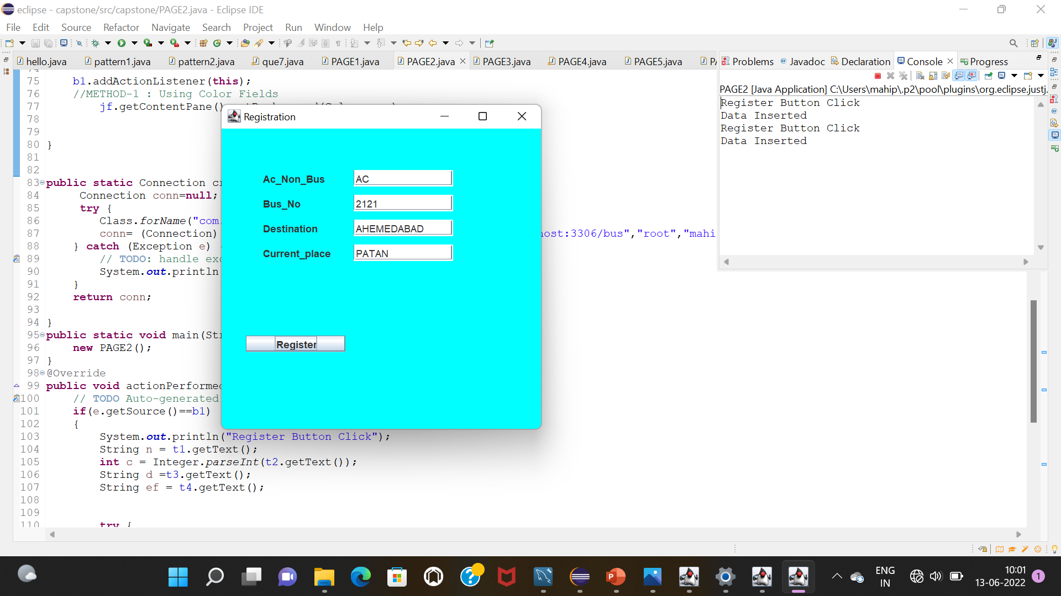
Second page:
Here we can see 4 input boxes when you can fell all the boxes and click on register . You will see console massage and also data save into mysql database

Slide 5
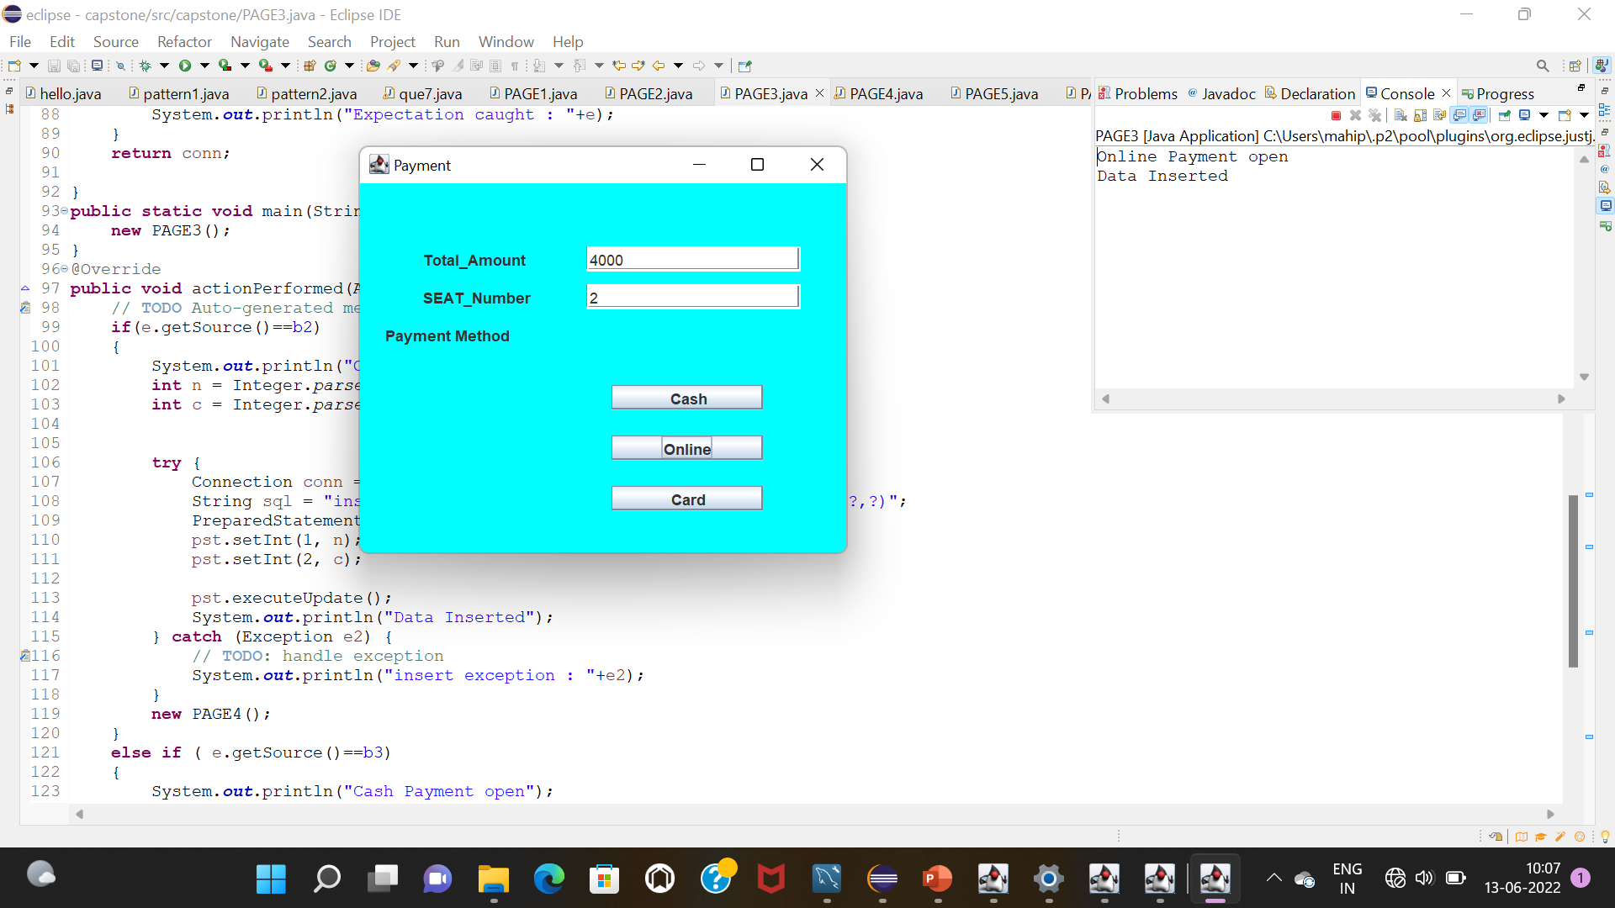
Third page:
Here you can see 2 insert area and 3 buttons .

Slide 6
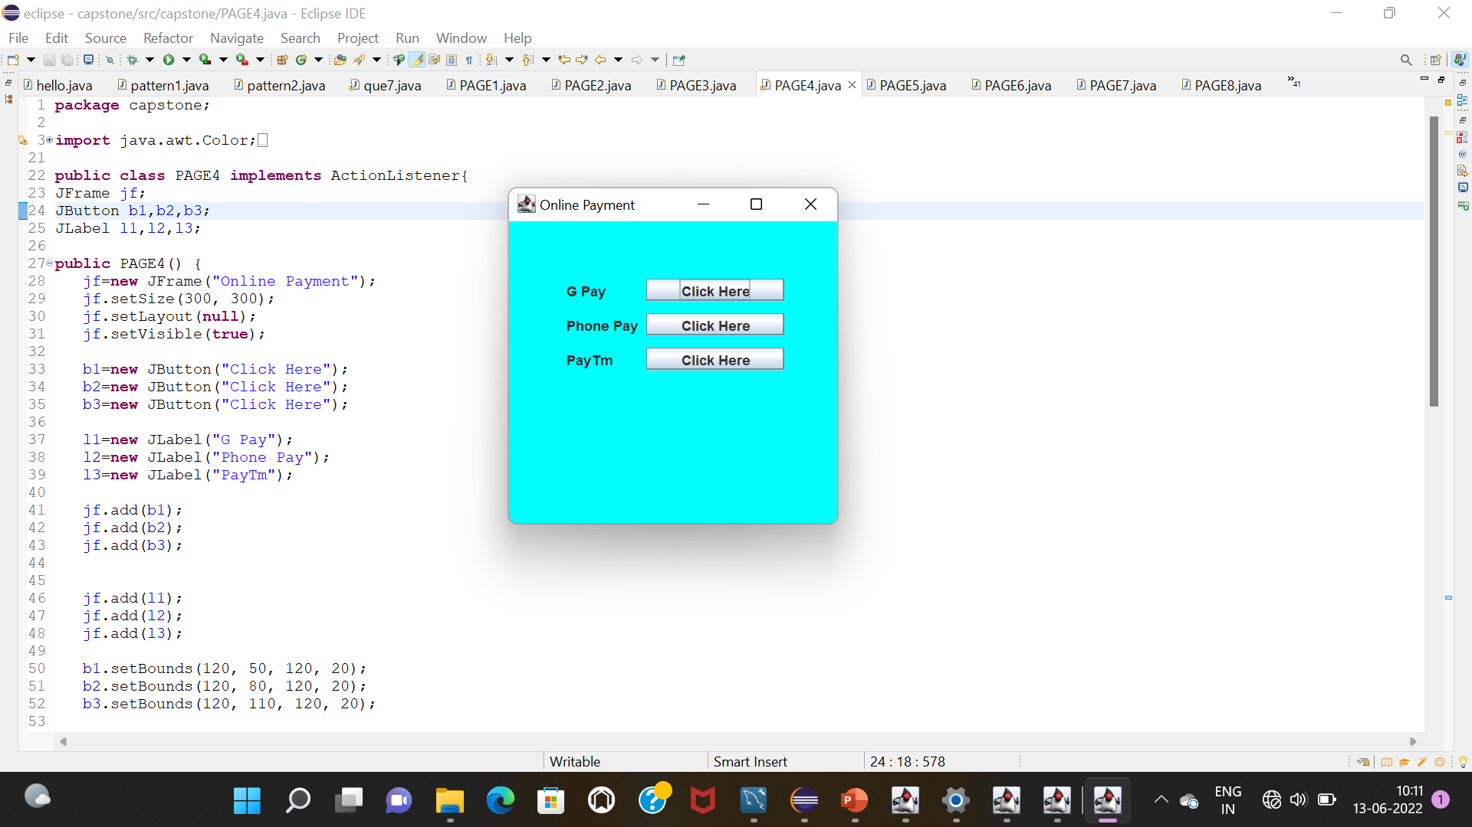
Fourth page:
Here you can see when you click online pay button there is open this page and here we see 3 button are available to payment

Slide 7
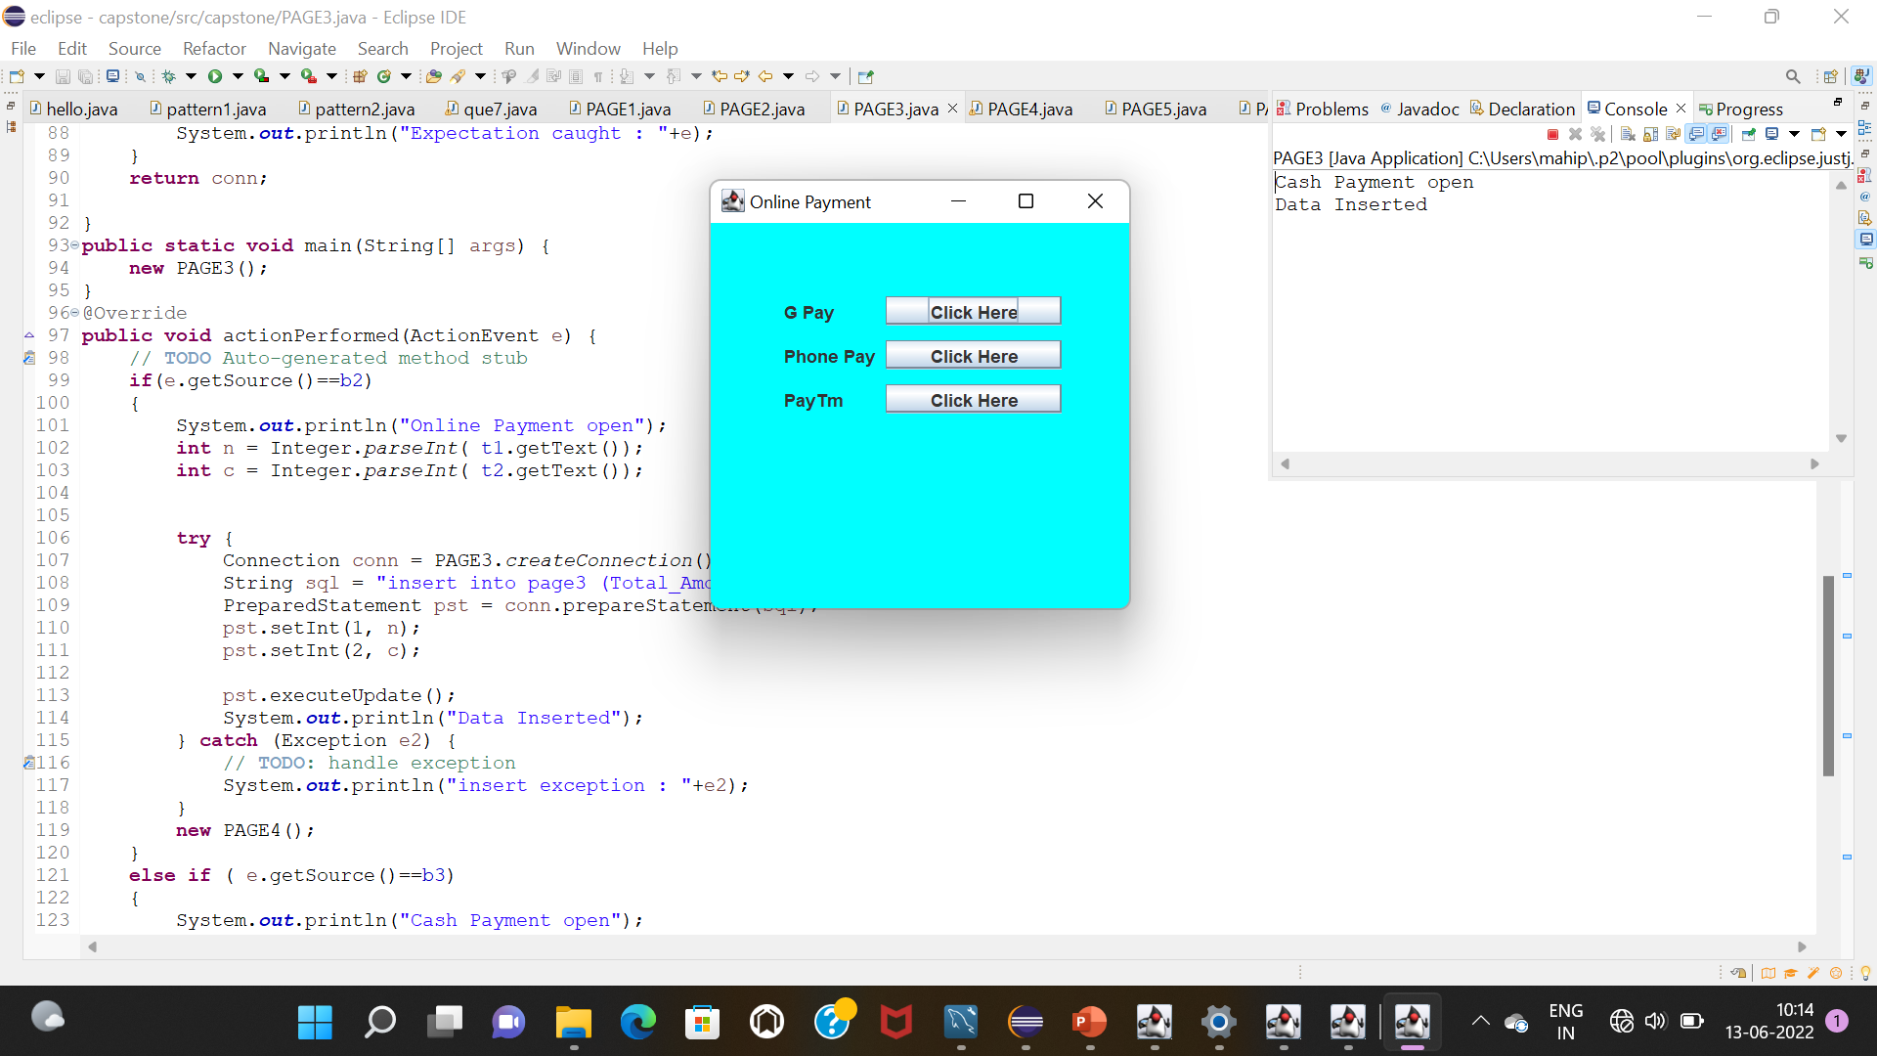
Console:
When you click on cash payments you will see the massage on console “cash payment open”
And also see data inserted into the database

Slide 8
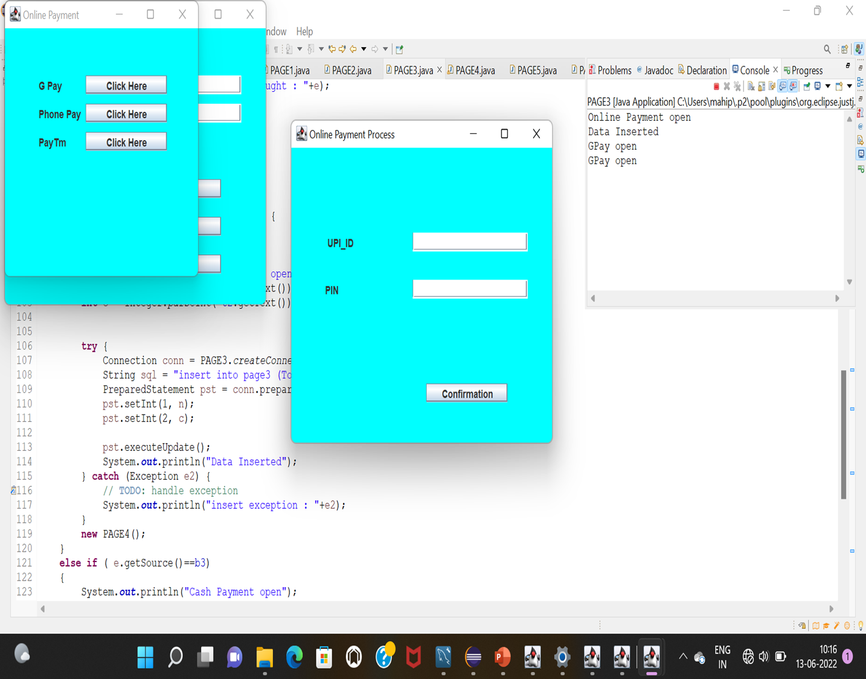
New page:
When you click on online payment button you will see another page it’s called “online payment process “ and when you fill the boxes and click on confirmation you will get another page

Slide 9
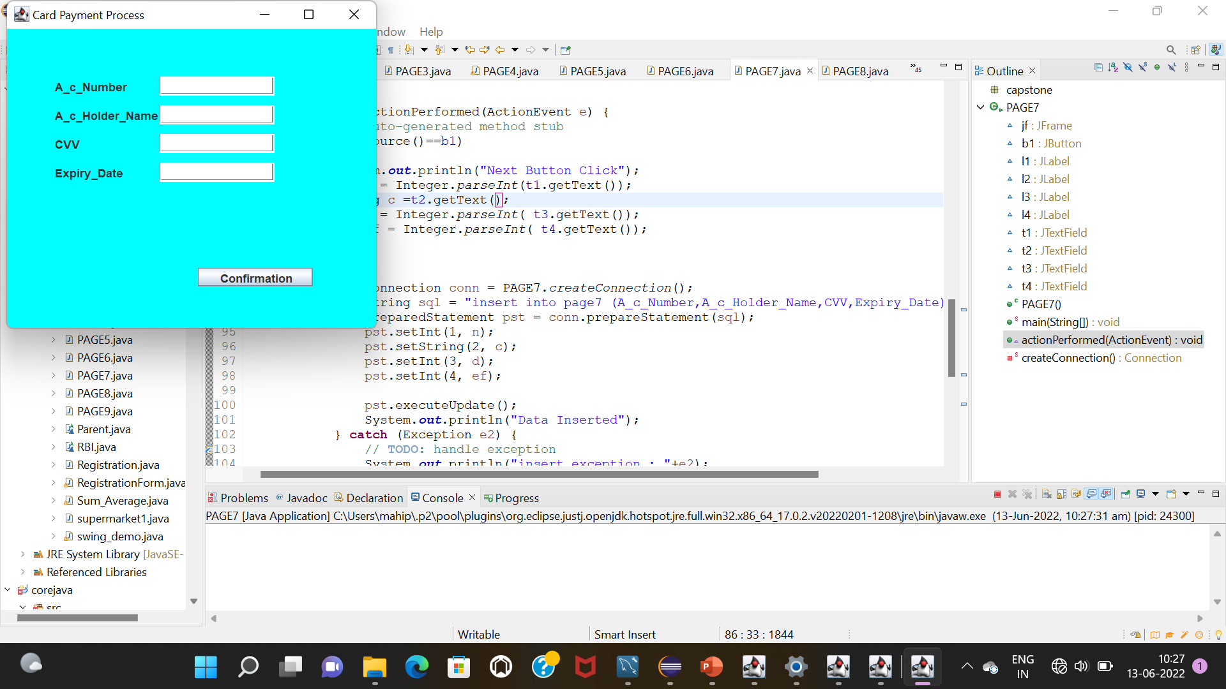
New page:
Here you can see when you click third’s page button “card payment”
You will see this page and when you fill this boxes and click on “confirmation” you will get another page.

Slide 10
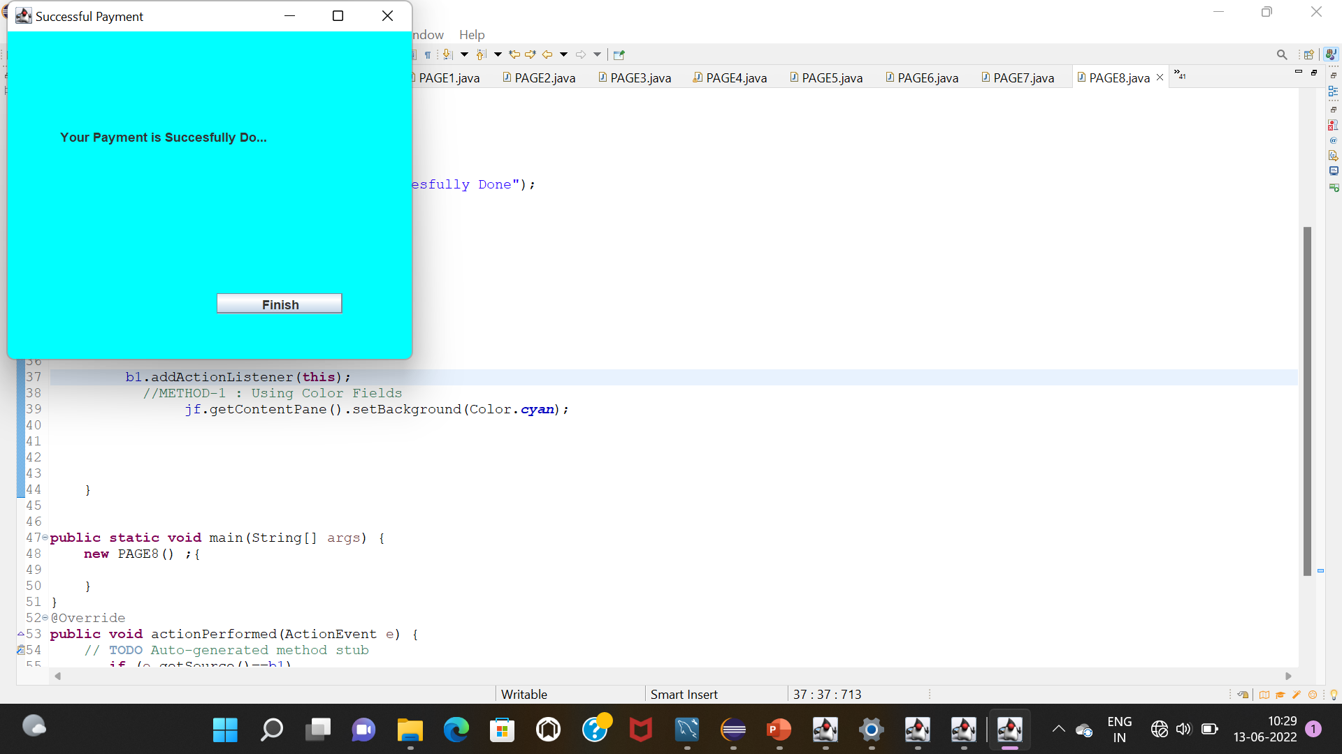
New page
When your payment is successfully done there page is open

Slide 11
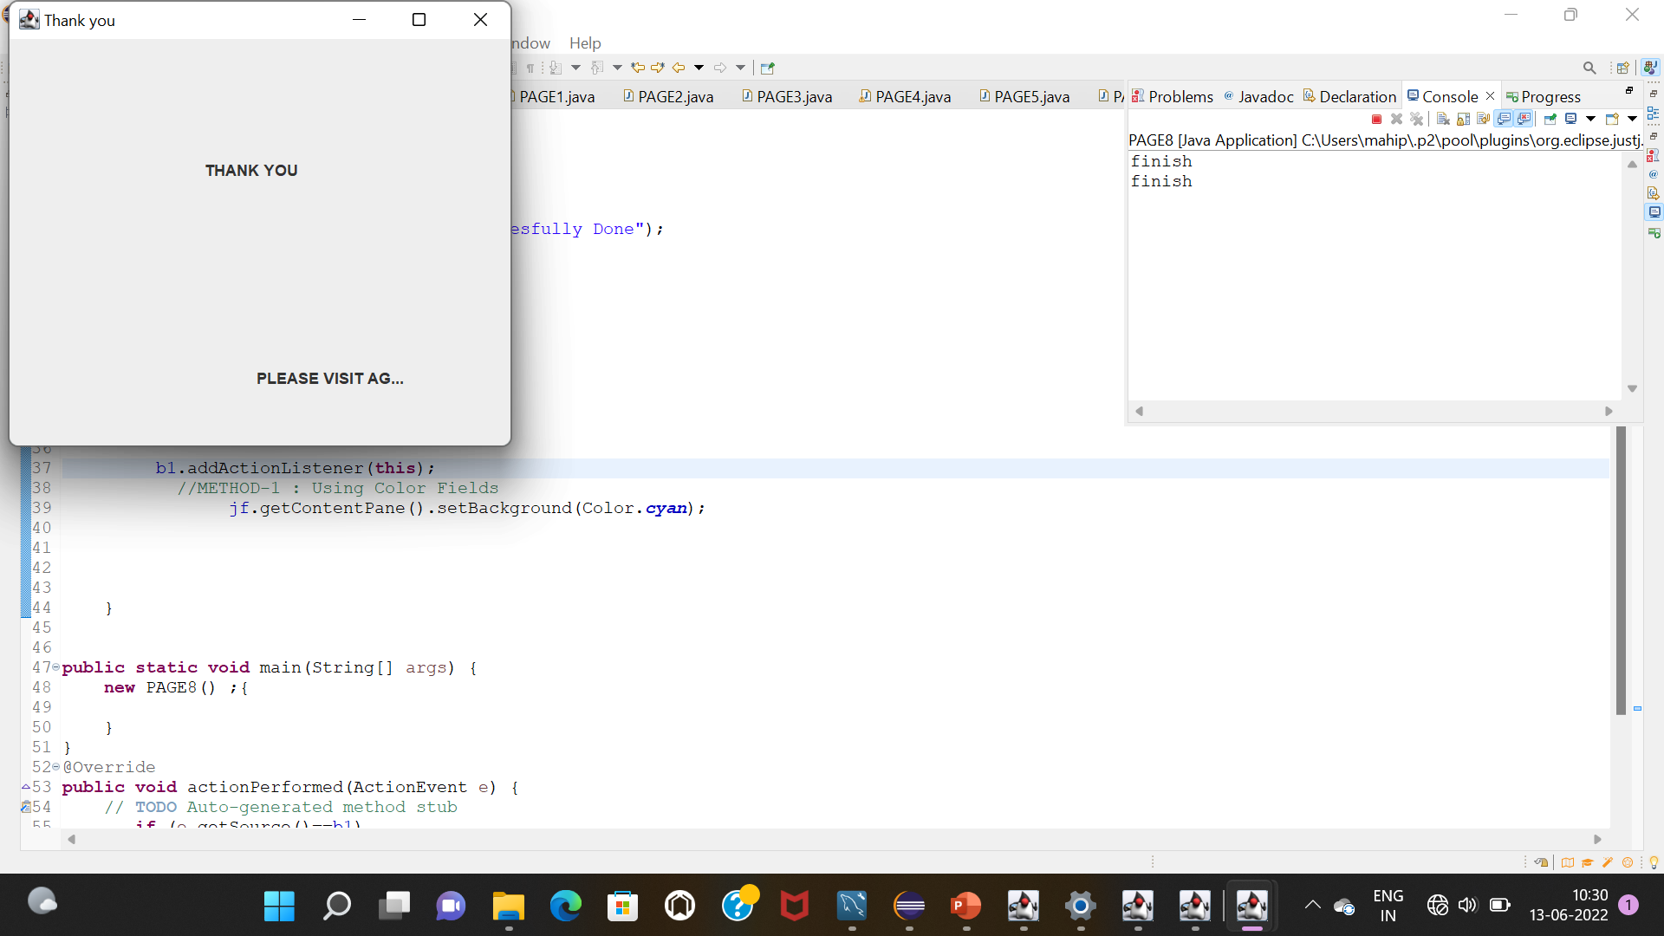
Last page
Here is the last page thank you page..

Slide 12
Mahi prajapati
E-no :96

